Slide 1
Culture and Imperialism 2

Slide 2
‘we shall see the far from accidental convergence between the patterns of narrative authority constitutive of the novel on the one hand and on the other, a complex ideological configuration underlying the tendency to imperialism’ (Said, 1993 : 82)

Slide 3
The links between novel and imperialism
Anglocentrism
There’ll always be an England ! - The 19th century novel stresses the continuing existence of England : ‘refining and articulating the authority of the status quo’ (91)

Slide 4
Structure of feeling
Continuity
Perceptions of England
Globalised view
Internal structure - worldliness, meta-narrative.

Slide 5
Contrapuntal reading
‘As we look back at the cultural archive, we begin to reread it not univocally but contrapuntally, with a simultaneous awareness both of the metropolitan history that is narrated and of those other histories against which (and together with which) the dominating discourse acts. In the counterpoint of Western classical music, various themes play off one another, with only a provisional privilege being given to any particular one; yet in the resulting polyphony there is concert and order, an organized interplay that derives from the themes, not from a rigorous melodic or formal principle outside the work’ (59)

Slide 6
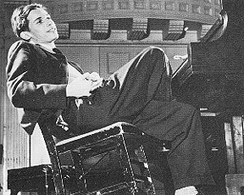

Glen Gould (1932 - 1982)

Slide 7
Contrapuntal reading (cont)
Passing references to empire
Polyphony - imperial narrative and counter narrative
Rhetoric of blame/Hybridity

Slide 8
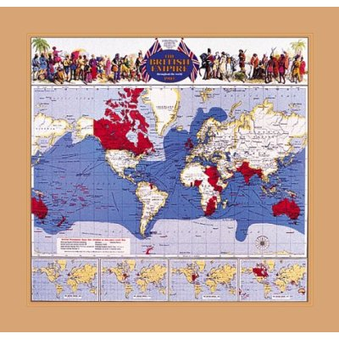
Geography
Rethinking ‘geography’
Geographical reality of imperialism
Mapping the world
Obscuring local realities

Slide 9
King solomon’s mines

Slide 10
Mansfield Park
‘More clearly than anywhere else in her fiction, Austen here synchronises domestic with international authority, making it plain that the values associated with such higher things as ordination (ordering and arranging), law, and propriety must be grounded firmly in actual rule over and possession of territory. She sees that to hold and rule Mansfield Park is to hold and rule an imperial estate in close, not to say inevitable association with it. What assures the domestic tranquility and attractive harmony of one is the productivity and regulated discipline of the other’ (104)

Slide 11
Mansfield Park

Slide 12
Mansfield Park
Mansfield Park as metonym and metaphor
Space and travel
Complicity in the imperial project
Town (England) and country (Antigua)

Slide 13
The cultural integrity of empire
The relationship between culture and politics
Imperialism as a doctrine only came into being after the 1880s yet those who espouse it at this time deploy a language ‘whose imagery of growth, fertility and expansion, whose teleological structure of property and identity, whose ideological discrimination between ‘us’ and ‘them’ had already matured elsewhere --in fiction, political science, racial theory, travel writing’ (128)
British power and authority

Slide 14
Mapping a theory of resistance
Resistance as a twofold process -
1) recovery of geographical territory
2) changing of cultural territory

Slide 15
‘The post imperial writers of the third world therefore bear their past within them-as scars of humiliating wounds, as instigation for different practices, as potentially revised versions of the past tending towards a post-colonial future, as urgently reinterpretable and redeployable experiences, in which the formerly silent native speaks and acts on territory reclaimed as part of a general movement of resistance from the colonist’ (256)

Slide 16

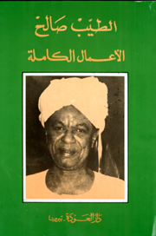
Writing back to empire
Ngugi Wa Thiongo’s ‘The River between’
Tayb Salih’s ‘Season of migration to the north’.

